Slide 1











Rossmann Sales Forecasting
Demand Modeling
Time Series
Promotions
Store Clustering
Predict product demand per store
Handle seasonality and trends
Account for campaign effects
Group similar locations
External Data
Model Ensemble
Evaluation
Deployment
Incorporate weather & events
Combine multiple algorithms
Track accuracy and bias
Automate forecasts to stores
Internship: Nexthikes IT Solution
Presented By: Deepa Pathak

Slide 2
Data at a Glance: Fueling Our Predictions
Our forecasting model was built upon three distinct, yet interconnected, datasets provided by Rossmann. Understanding their structure and volume was the first crucial step.
1
2
3
Train.csv
Test.csv
Store.csv
Over 1 Million Records: This extensive dataset provided historical daily sales data, including store details, promotion status, and customer counts. It was the backbone for model training.
41,000+ Records: This dataset contained the future dates for which sales predictions were required. It mirrored the structure of the training data but lacked the actual sales figures.
Store-Specific Details: A supplementary dataset providing static information about each store, such as store type, assortment, nearest competition distance, and ongoing promotions.

Slide 3
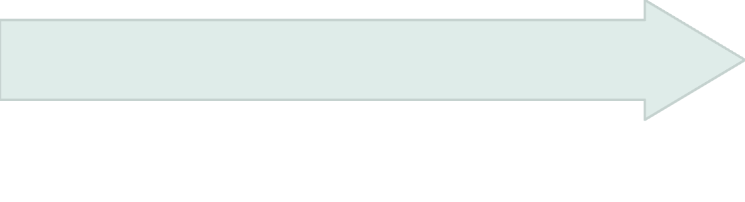
Data Preparation: Laying the Foundation for Accuracy
Raw data, no matter how vast, requires meticulous cleaning and structuring to be valuable for machine learning. Our data preparation phase involved several critical steps to ensure data quality and model readiness.
Missing Value Imputation
Zero-Sales Removal
Careful strategies were employed to handle missing values, using statistical methods or domain-specific logic to fill gaps and maintain data integrity.
Dataset Merging
Records indicating zero sales (typically when stores were closed) were identified and removed from the training data to avoid skewing the model's learning of actual sales patterns.
The three separate datasets (train.csv, test.csv, and Store.csv) were systematically merged based on common identifiers to create a comprehensive view.

Slide 4




Feature Engineering: Unlocking Deeper Insights
Beyond the raw data, we engineered new features that captured temporal patterns and competitive dynamics. These derived features significantly enhanced the model's ability to identify underlying sales drivers.
Year, Month, WeekOfYear
CompetitionOpen
Extracted from the Date column, these features captured yearly trends, monthly seasonality, and weekly sales cycles (e.g., weekends vs. weekdays).
Calculated the number of days a competitor store had been open nearby, providing insight into competitive pressure over time.
Promo2Open
Future Enhancements
Determined the number of days a store had been participating in a continuous promotion, indicating the duration and potential impact of ongoing marketing efforts.
Consideration for external factors like local holidays, school breaks, and even weather patterns were noted for future feature additions.

Slide 5
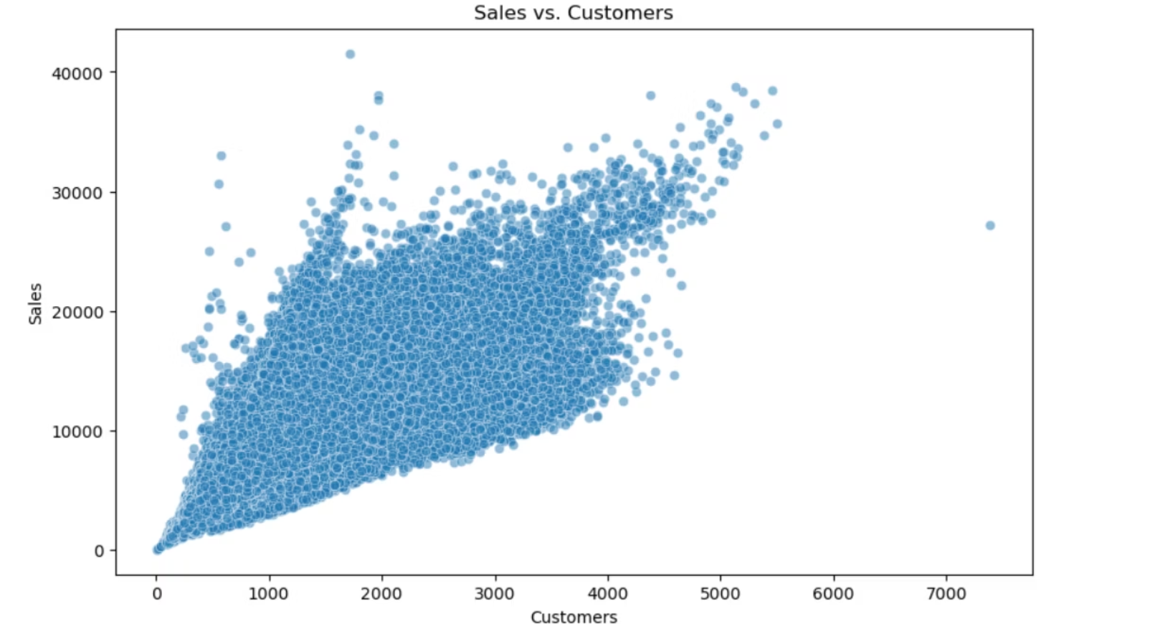
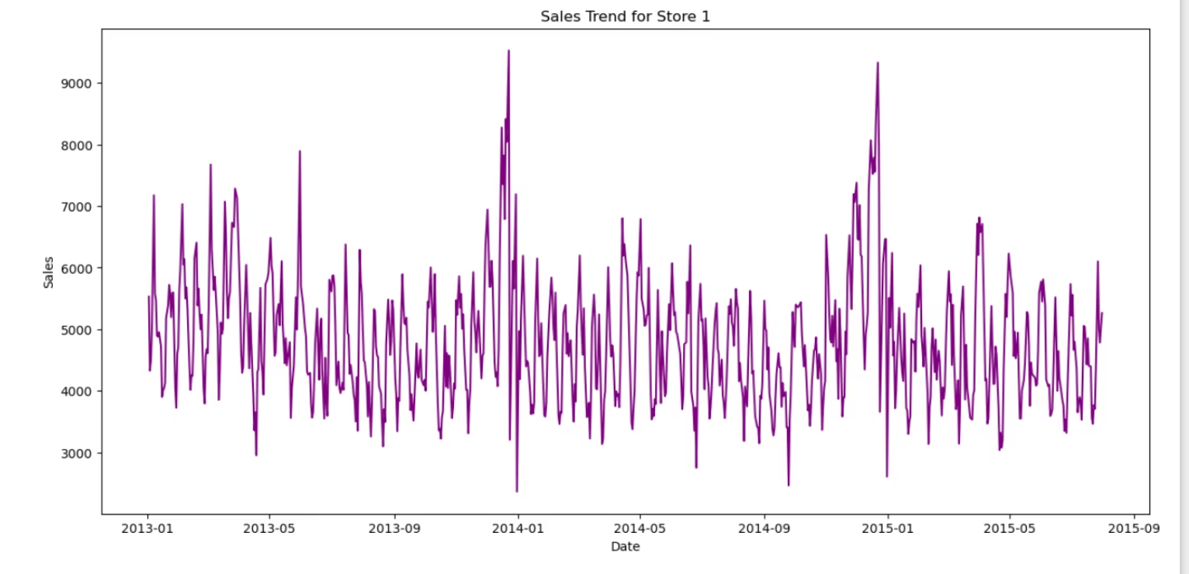
Graph

Slide 6
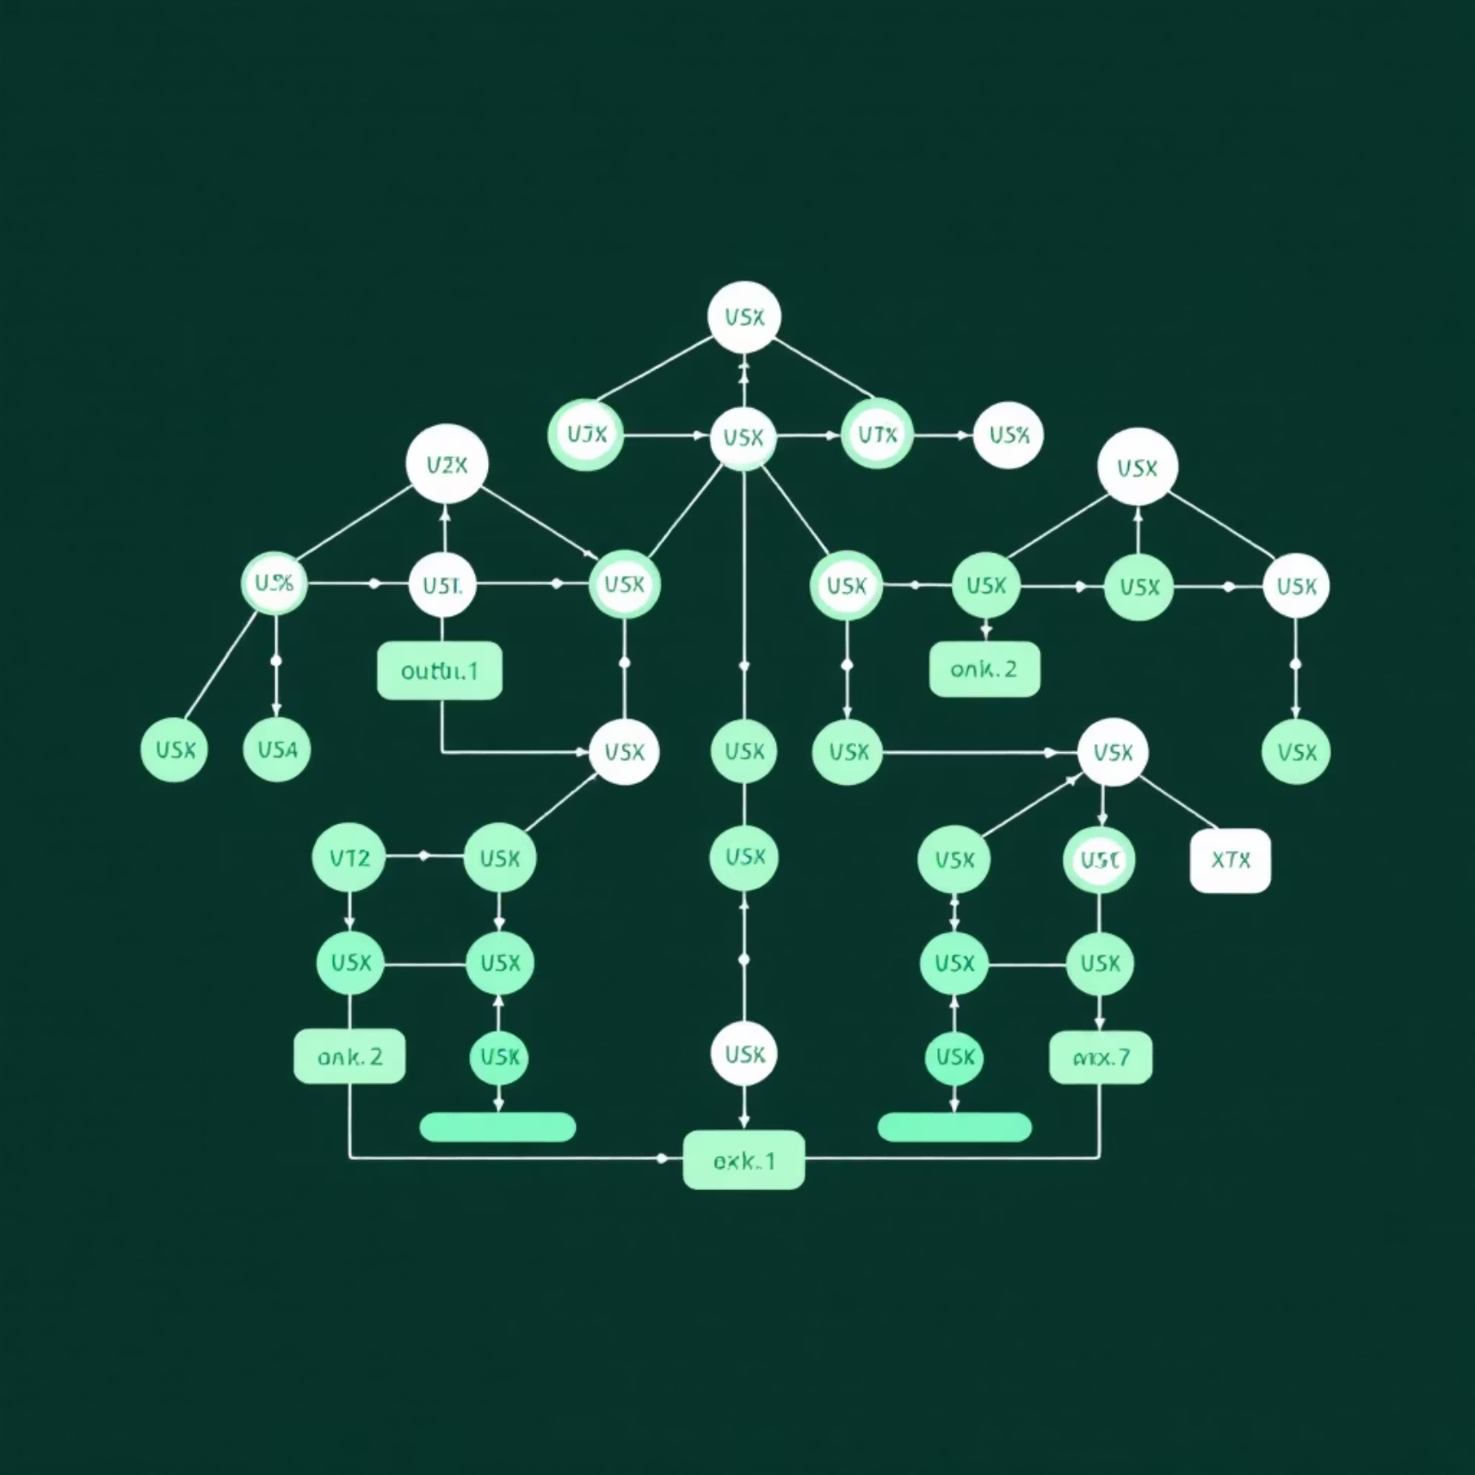
Model Selection: The Power of XGBoost Regressor
For this complex forecasting challenge, we chose the XGBoost Regressor. Its robust architecture and proven performance make it an ideal choice for problems with intricate, non-linear relationships and diverse feature sets.
Why XGBoost?
Handles Non-Linearity: Effectively captures complex, non-linear relationships between various features (e.g., promotions, competition, time of year) and sales.
High Performance: Known for its speed and accuracy, often outperforming other algorithms on structured data.
Feature Importance: Provides insights into which features contribute most to predictions, aiding in business understanding.
Regularization: Built-in regularization helps prevent overfitting, leading to more generalized and reliable forecasts.

Slide 7
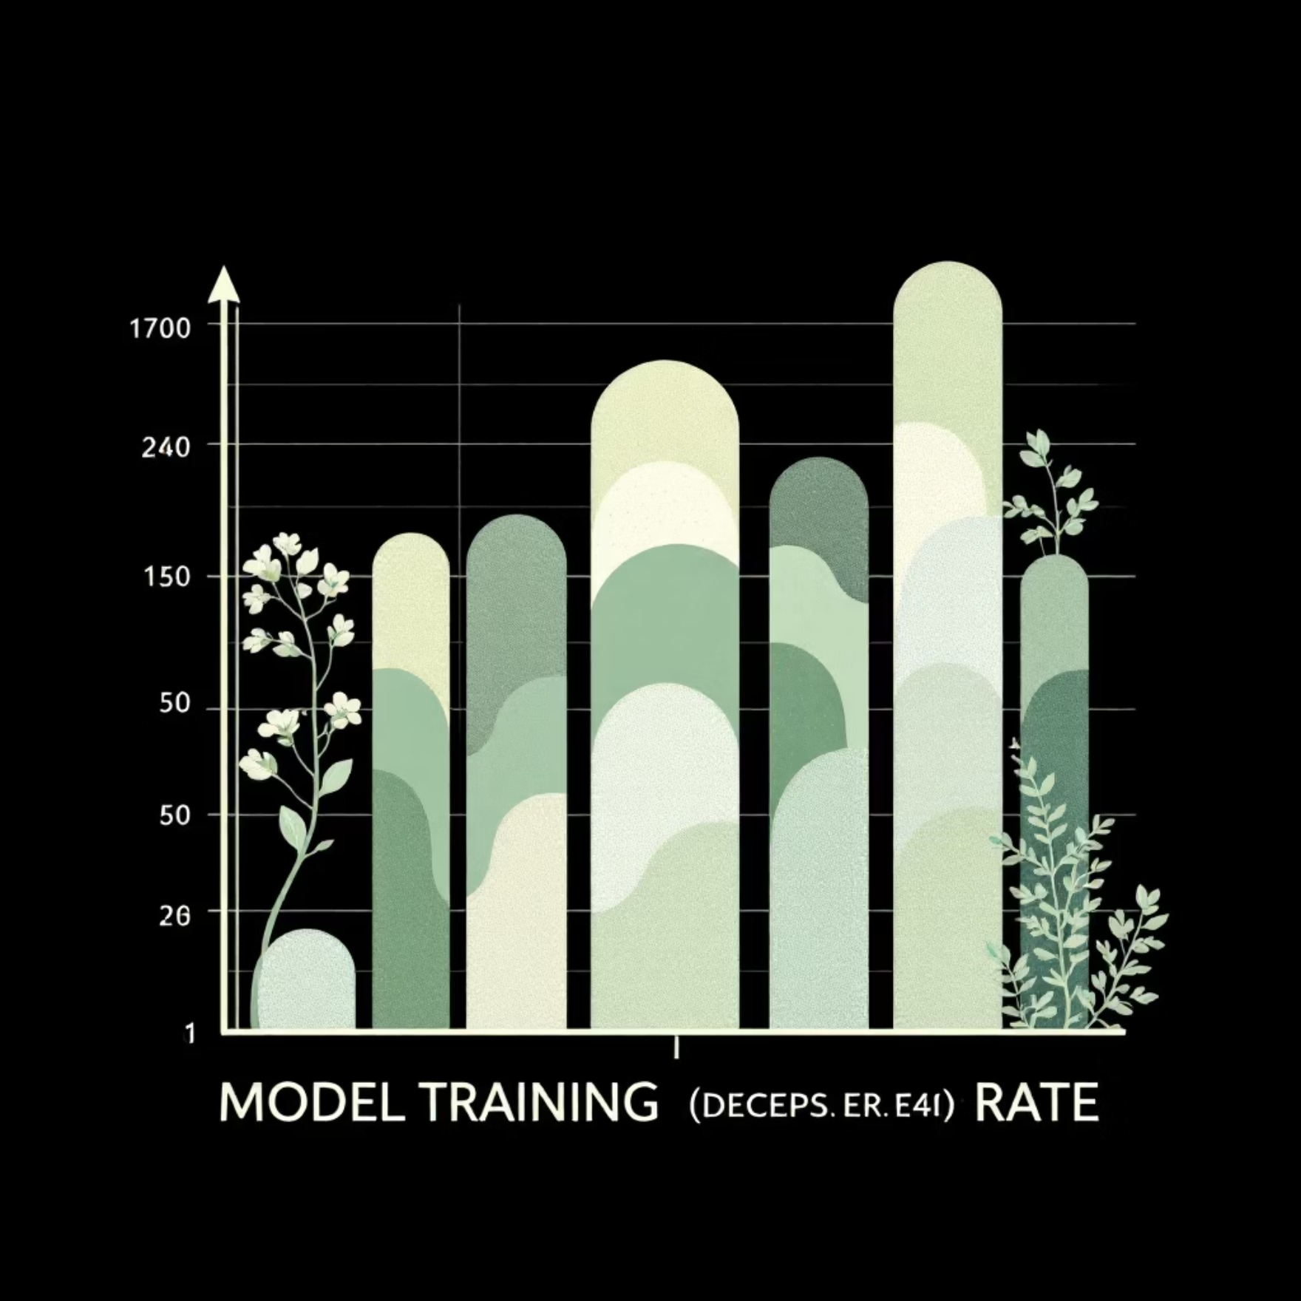
Model Training & Evaluation: Proving Predictive Power
With clean data and engineered features, the XGBoost model was trained. Evaluating its performance rigorously was key to ensuring its reliability for real-world application.
Training Process
Evaluation Metric: RMSPE
The model ingested the prepared historical data, learning the intricate patterns and relationships that drive sales. This involved an iterative process of adjusting internal parameters to minimize prediction errors.
We primarily used the Root Mean Square Percentage Error (RMSPE) to evaluate the model. RMSPE is particularly suitable for sales forecasting as it penalizes larger percentage errors more, giving a clear indication of prediction accuracy relative to actual sales values.
Where y_i is the actual sale and \hat{y}_i is the predicted sale.

Slide 8
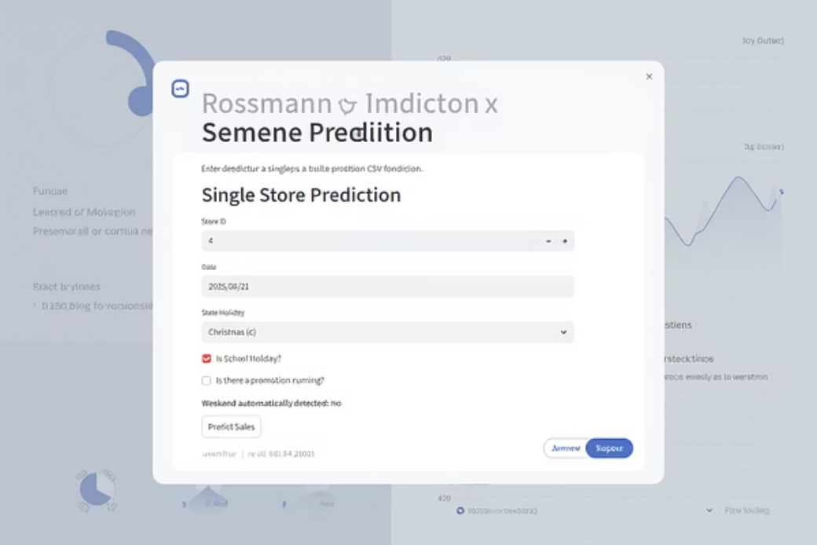
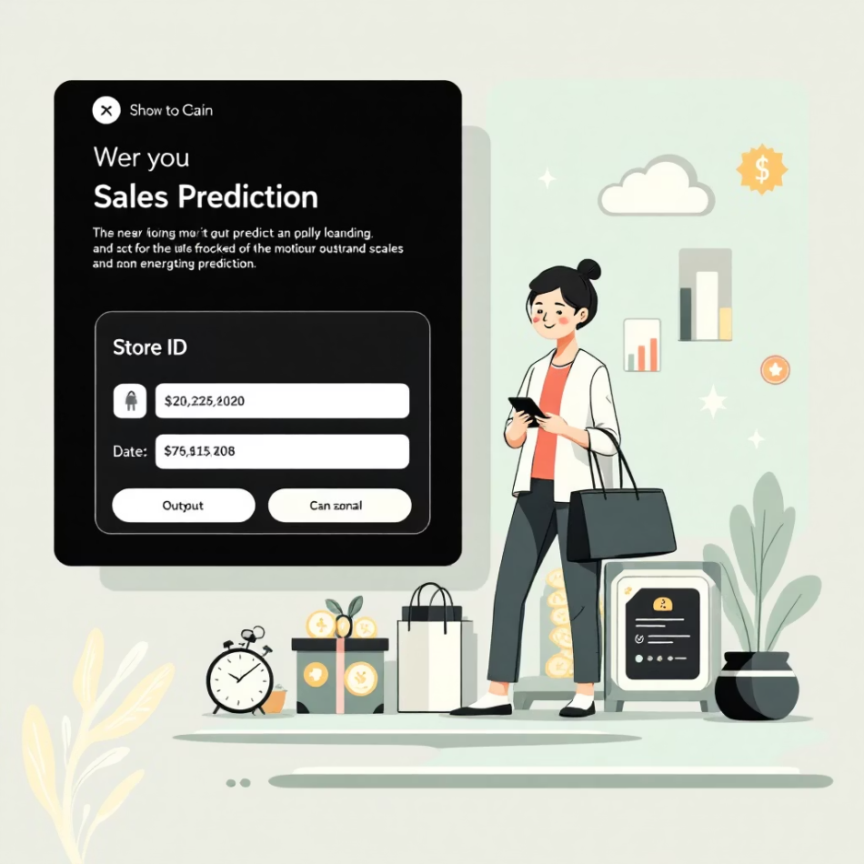
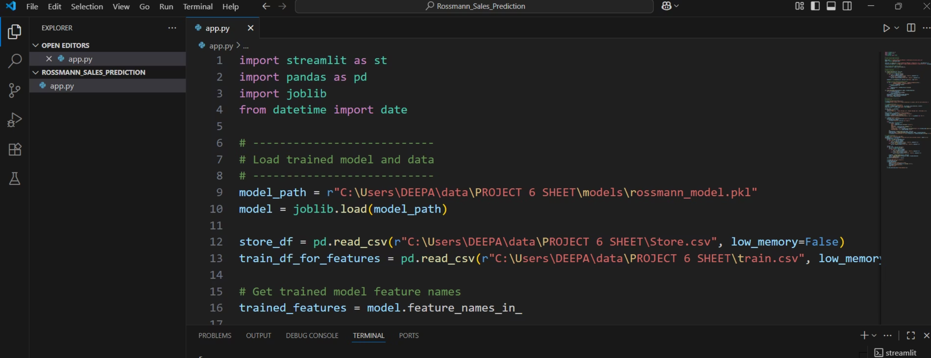
Deployment: From Model to Real-Time Predictions
Interactive Interface: Users can select specific dates and store IDs to get instant sales predictions.
Trained Model Loading: The application efficiently loads the pre-trained XGBoost model, ensuring quick response times.
Real-time Forecasts: Provides immediate insights into projected sales, supporting dynamic decision-making for inventory, staffing, and promotions.

Slide 9
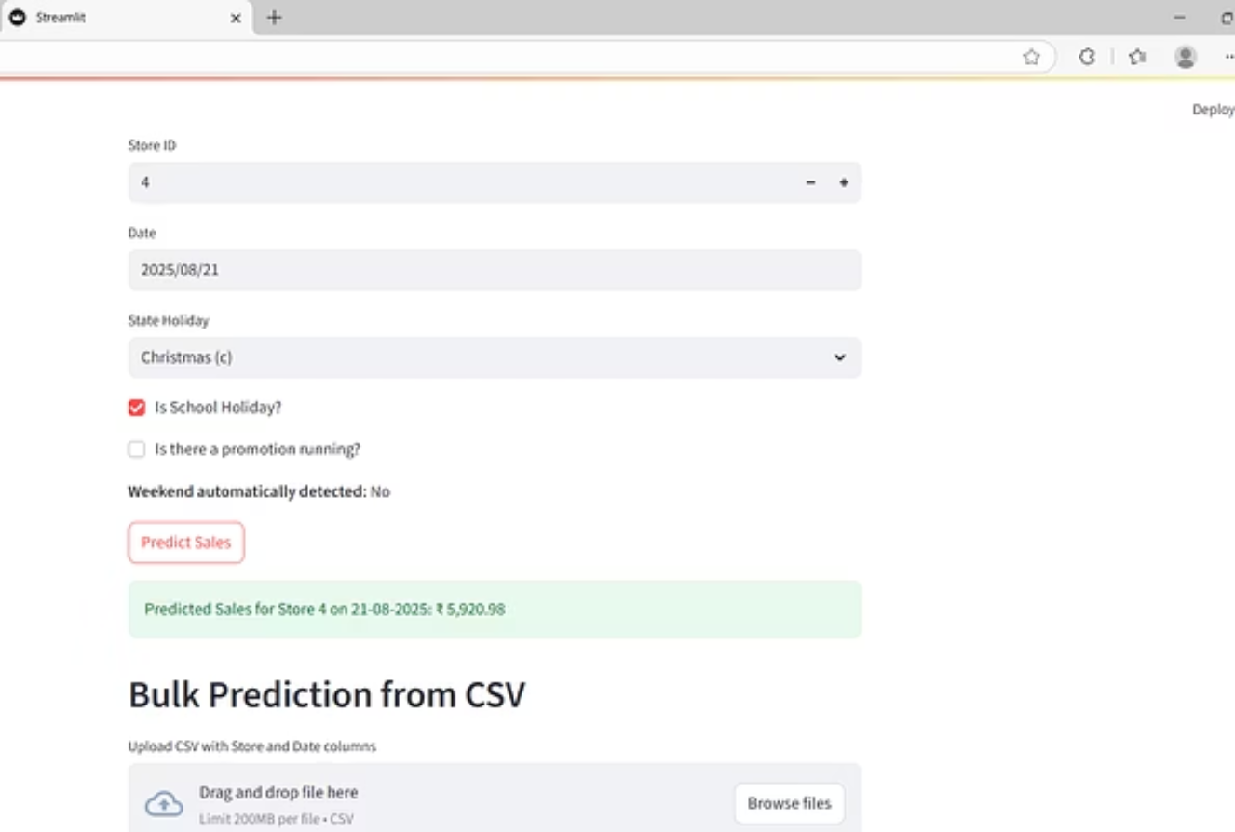
Deployment: From Model to Real-Time Predictions
To make the forecasting solution accessible and actionable for Rossmann management, we developed an intuitive web application using Stream lit.

Slide 10


Future Work: Continuous Improvement & Expansion
The current forecasting solution provides a strong foundation, but the journey of improvement is continuous. Here are key areas for future development:
Hyperparameter Tuning
Advanced Feature Engineering
Model Stacking/Ensembling
Fine-tuning the XGBoost model's hyperparameters using techniques like GridSearchCV or RandomizedSearchCV to further optimize performance.
Integrating external data (e.g., local events, weather, economic indicators) and creating more complex interaction features to capture nuanced sales drivers.
Combining predictions from multiple diverse models (e.g., ARIMA, LightGBM, Neural Networks) to potentially achieve higher accuracy and robustness.

Slide 11
Factors Influencing Rossmann's Sales & Feedback 👇
Based on the data analysis, sales are significantly higher during promotions and are directly influenced by store type and competition distance. Sales predictably drop on holidays and show clear seasonal and weekly patterns.
Positive Feedback: The project successfully delivers on the core objective of sales forecasting. The use of a powerful model like XG Boost ensures high accuracy, and the Stream lit app makes the predictions easily accessible. The end product is a valuable asset that can be integrated into the finance team's planning process.
Negative Feedback & Next Steps: For a more advanced and accurate solution, we recommend further investment in two key areas. First, we could explore Deep Learning models, such as LSTM networks, which are specifically designed for time-series data and can capture more complex patterns. Second, implementing MLOps tools like DVC and MLFlow would allow us to track and manage different data and model versions, ensuring the project is scalable and maintainable for the long term.

Slide 12

Thank You!
Git hub: DataWithDeepa (Deepa Pathak)
Email ID: deepapathak121@gmail.com

